Slide 1

Digital Logic Design

Slide 2
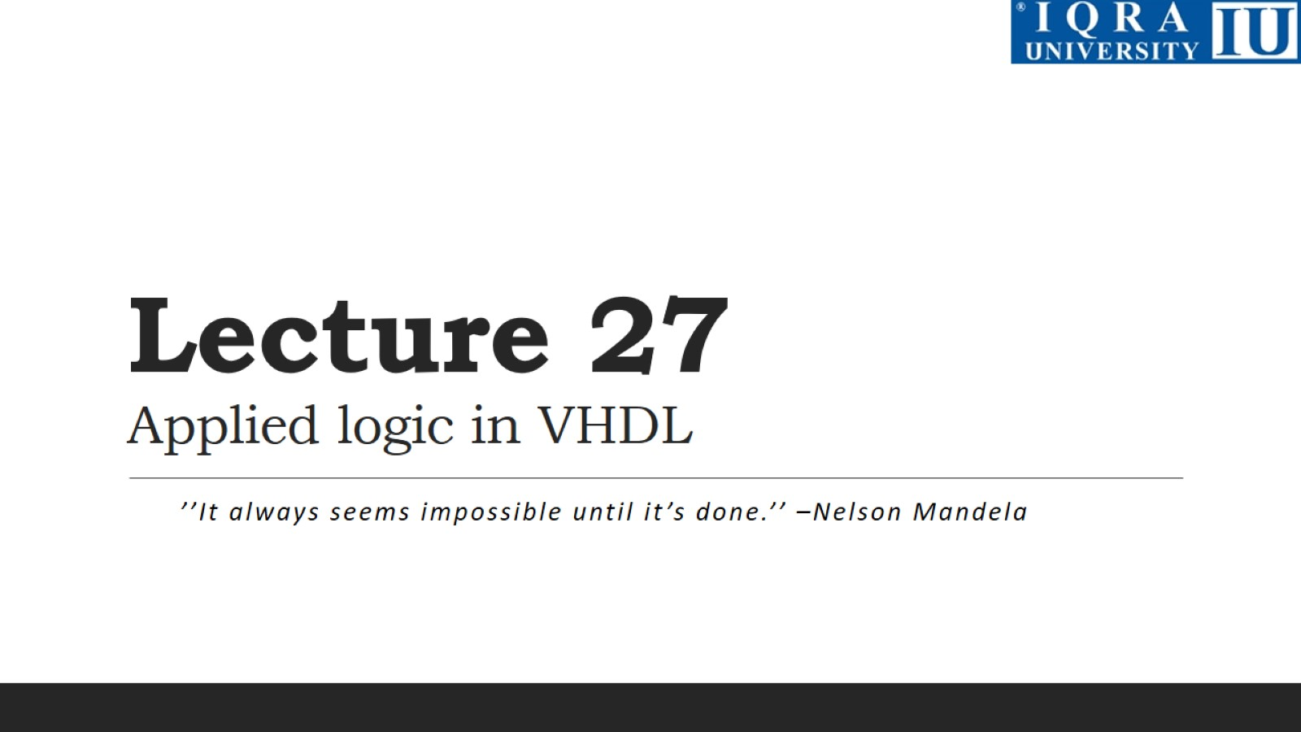
Lecture 27 Applied logic in VHDL

Slide 3
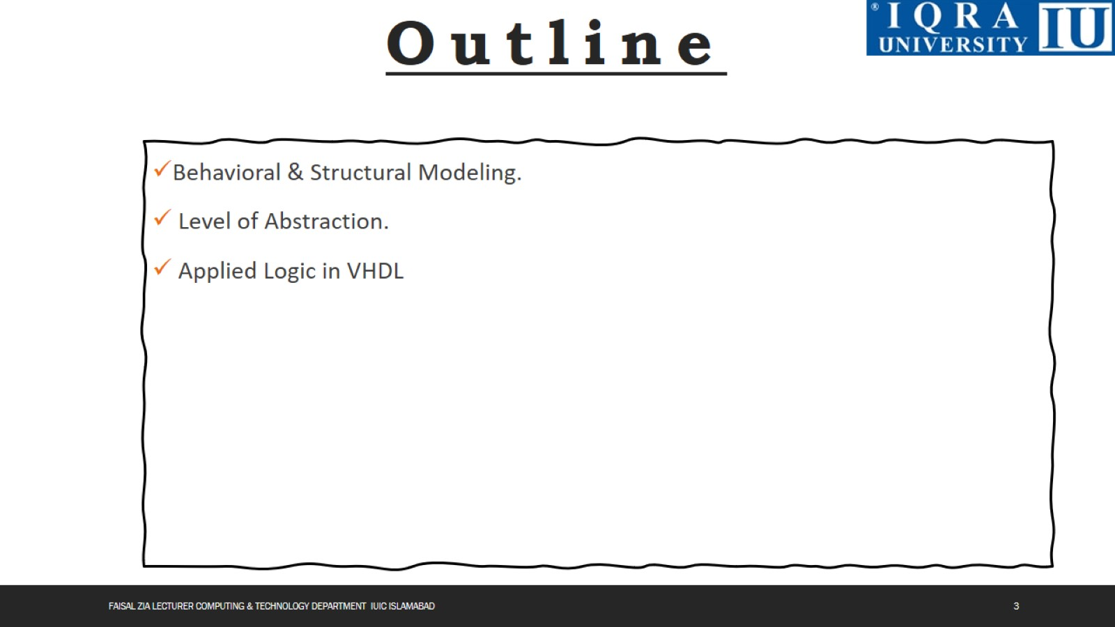

Slide 4
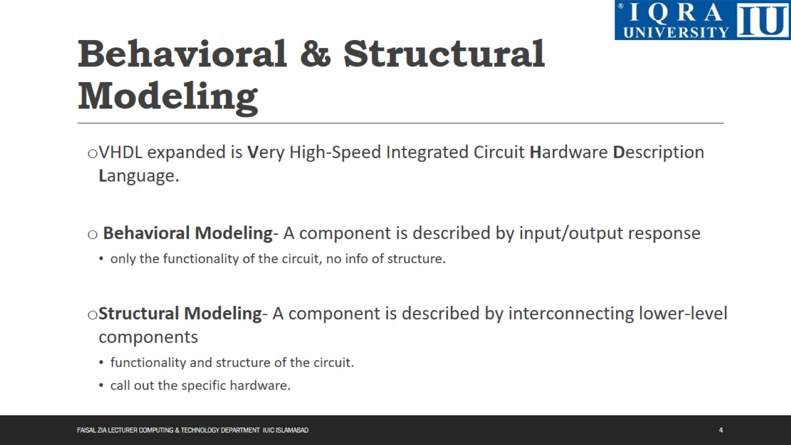
Behavioral & Structural Modeling

Slide 5
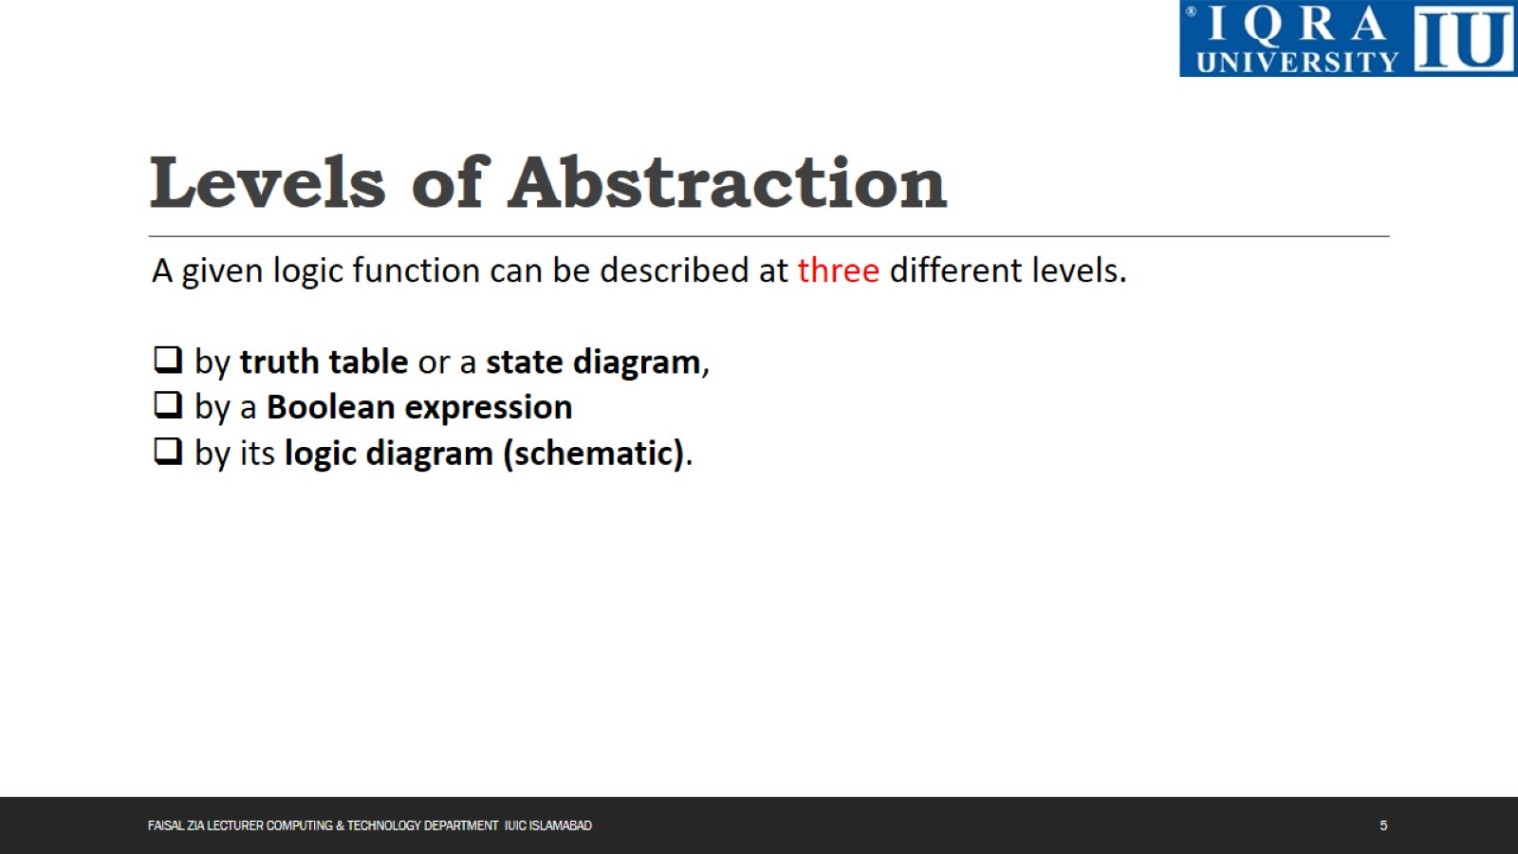
Levels of Abstraction

Slide 6
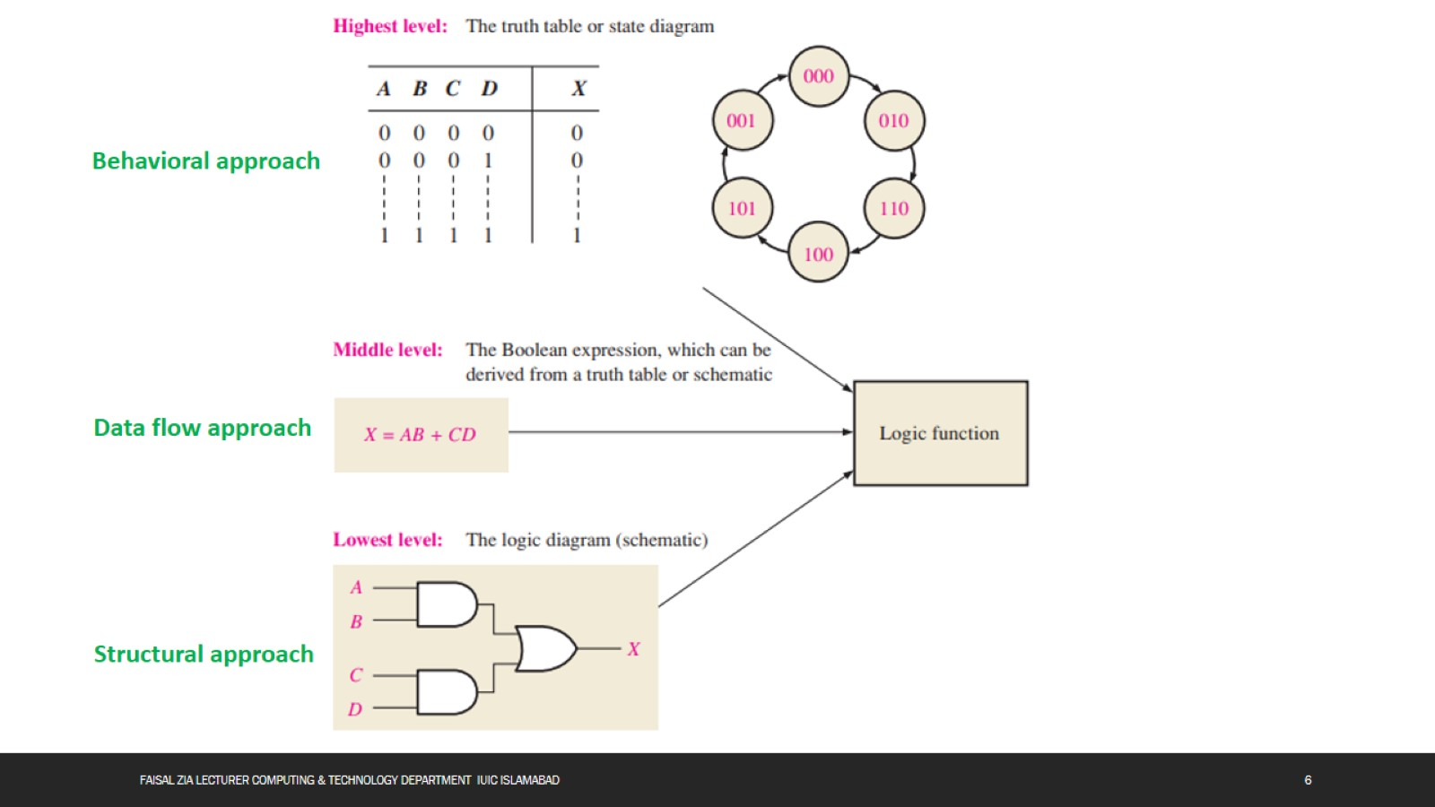

Slide 7
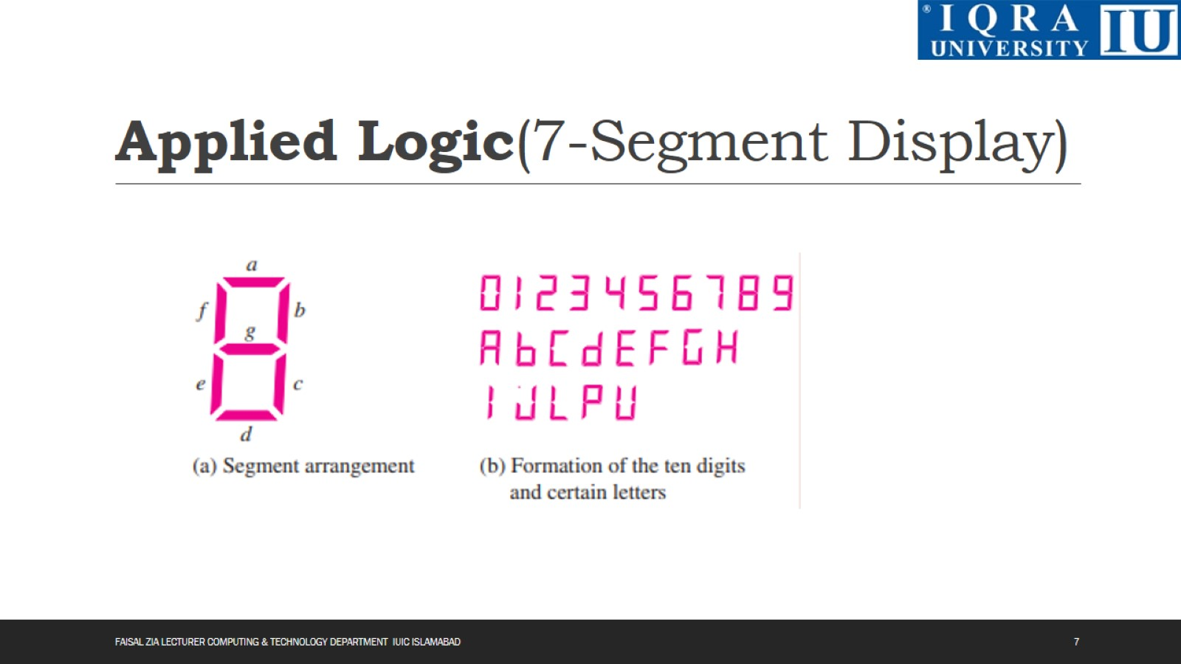
Applied Logic(7-Segment Display)

Slide 8
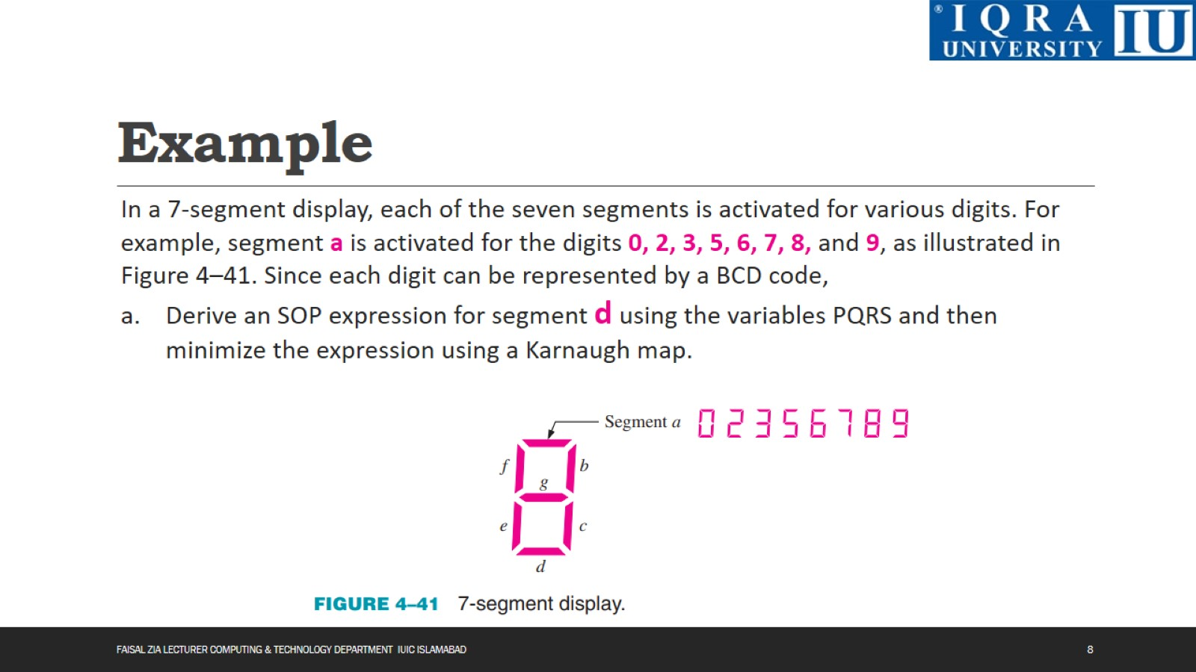
Example

Slide 9
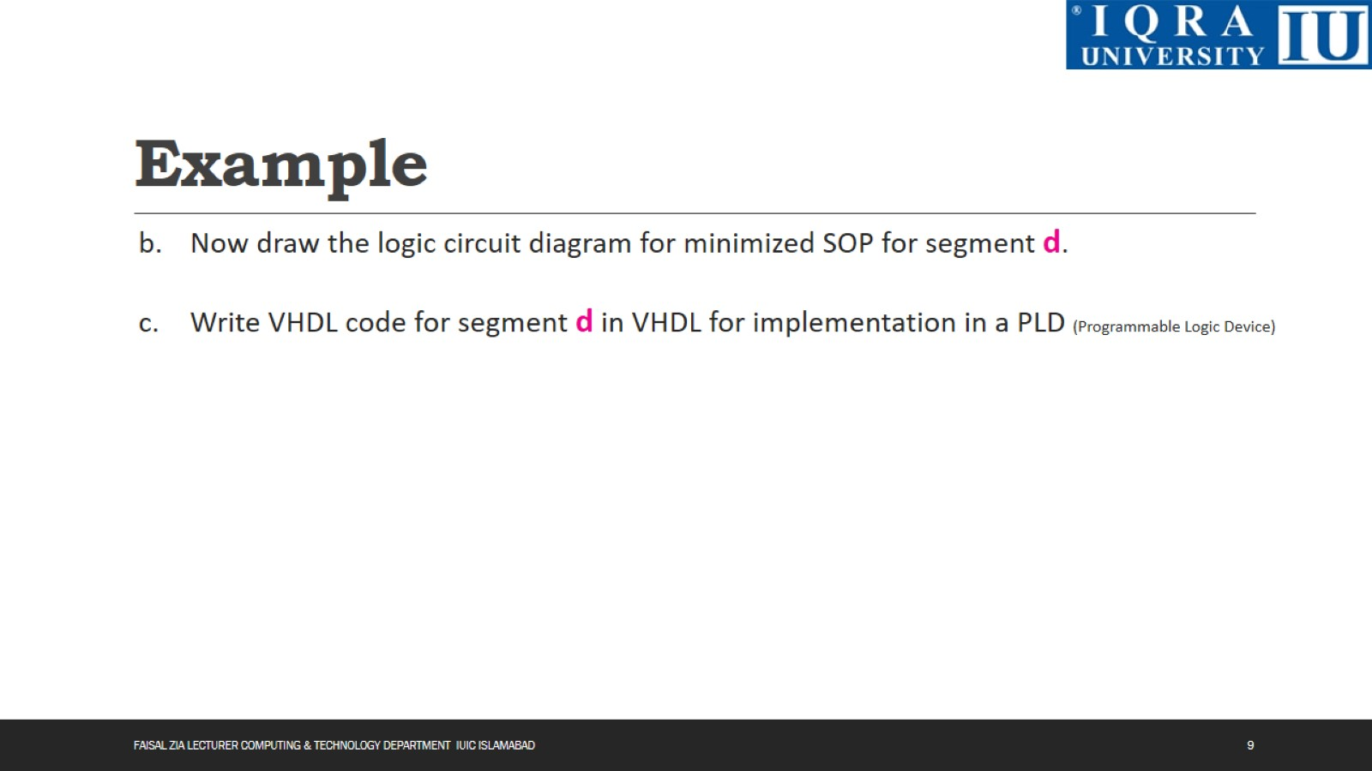
Example

Slide 10
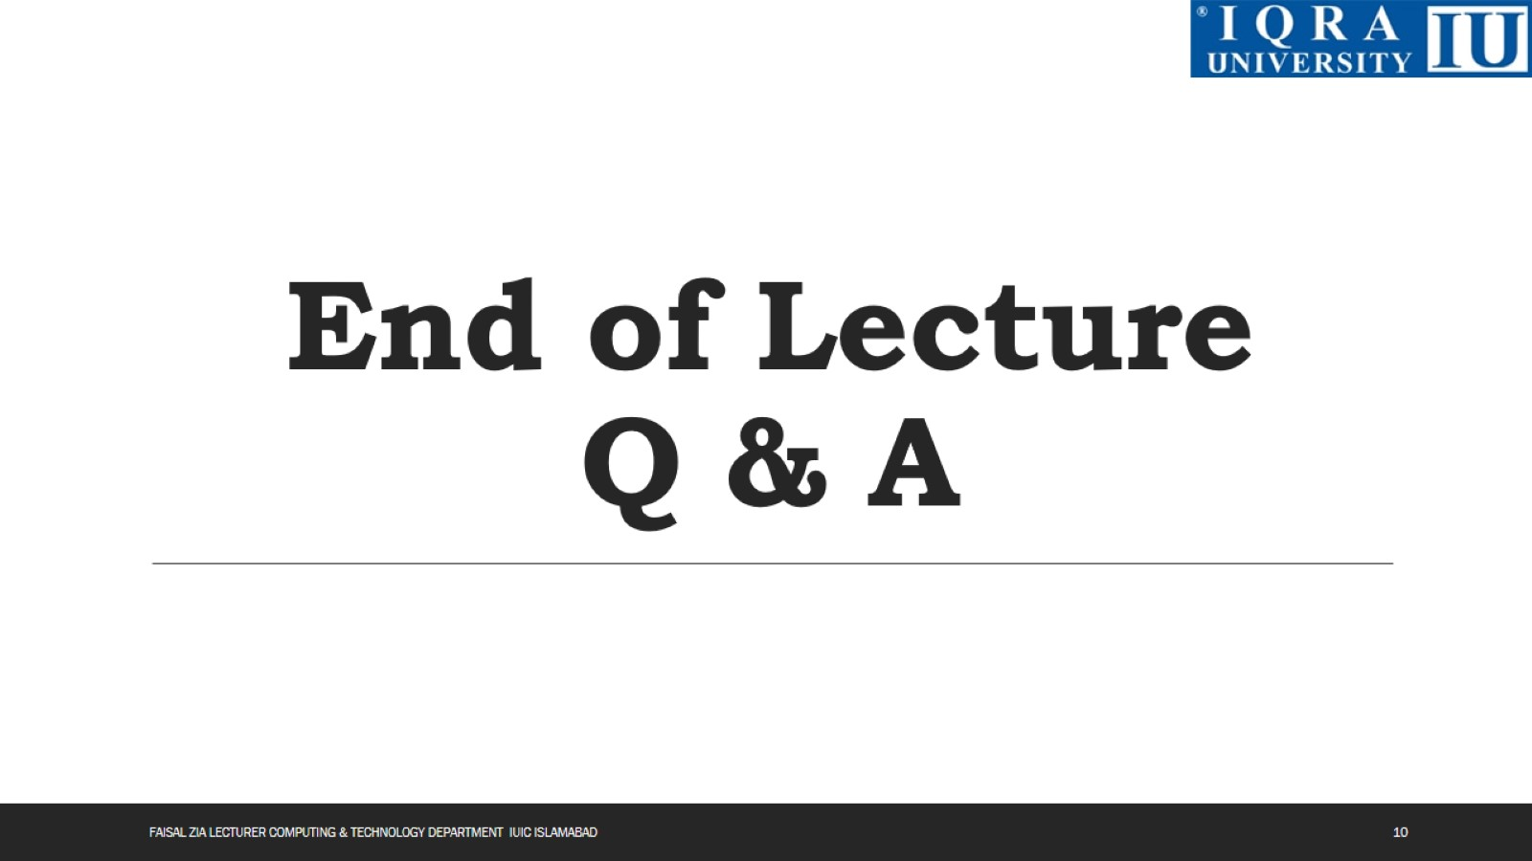
End of Lecture Q & A

